Slide 1
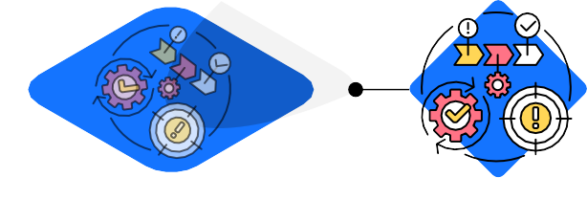
DO YOU HAVE A PLAN
TO RECOVER YOUR DATA?
BACKUP DISASTER RECOVERY
Technology
WHY YOU NEED IT
It is crucial to have a contingency plan ready in case of data loss. You must backup all sensitive information securely as part of your safe-data procedures.
PROCESS
A backup and disaster recovery plan is a group of procedures, data storage, and retrieval tools to manage your data securely. Data restoration is a key part of these strategies. A solid disaster recovery plan will limit losses by keeping recent copies of your data in a safe and secure undisclosed location.
CHALLENGES
Data loss or damage is an inevitable result of the many problems encountered when running a business. Hurricanes,
oods, res, and earthquakes are only some examples of natural disasters that could lead to data loss. Hardware problems, like an electrical surge or a pipe that bursts, can damage your hard drives and cause you to lose data.
BENEFITS
When it comes to data backup solutions, we have the most reliable backup and disaster recovery solutions for any business. Manage Service Providers understand how to form a complete Data Backup and Recovery solution to store your data and reinstall it to get you up and running quickly. Not only is your data safe, but it will take you just one phone call to start the recovery process.
WHY YOU NEED BDR MANAGMENT
Reliable BDR solutions secure your data in multiple ways. You need to store a copy of your data to make sure your business can keep running after a loss of data. Depending on the damage, your company may have trouble remaining open. However, with a disaster recovery plan, your business can resume business as usual, often within hours.
We manage your BDR so you can manage your business. Give yourself some time and peace of mind back, call us today.
(661) 464-1135
www.arrc.com
Contact Us to Get a Free Consult

